Slide 1
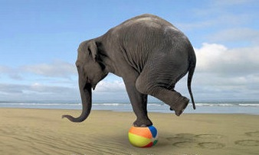
1.1.5 Explain the nature of equilibrium

Slide 2
What is equilibrium?
the average condition of a system in balance over a specific period of time
Your syllabus identifies two types:
  Steady-state equilibrium
  Static equilibrium (yawn!)

Slide 3
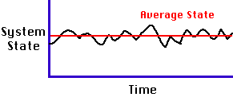
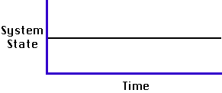
Graphing Equilibrium
Steady Systems:
Static Systems:
changes over time
Many ‘natural’ open systems
inputs = outputs (balance)
Negative feedback
No change over time
Mostly NON-living systems
No input or output
No feedback

Slide 4


1.1.6 Define and explain the principles of positive feedback and negative feedback.

Slide 5
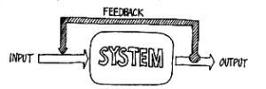
Feedback
Negative
Positive
return the system towards the norm
self-regulating
Leads to a steady-state equilibrium
it counteracts deviation from the norm
input = output
decreases, reduces or dampens the amount of change
Pushes the system away from the norm
Unregulated
Unsteady, unstable, out of balance
accelerates deviation from the norm
output increases output
increases the amount of change (exacerbates the problem)

Slide 6
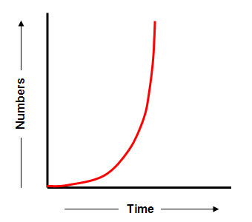
Recap: system state and feedback

Slide 7
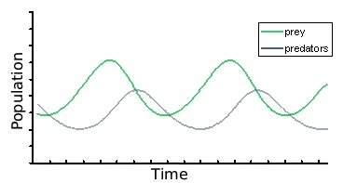
What type of feedback is this?

Slide 8


